Slide 1







My First AI Model
A crash course in building your own AI model from scratch
Miss Emma Van de Wouwer
emmanelly.vandewouwer@hdr.qut.edu.au
Dr. Andrew Stephens
Andrew.F.Stephens@qut.edu.au

Slide 2
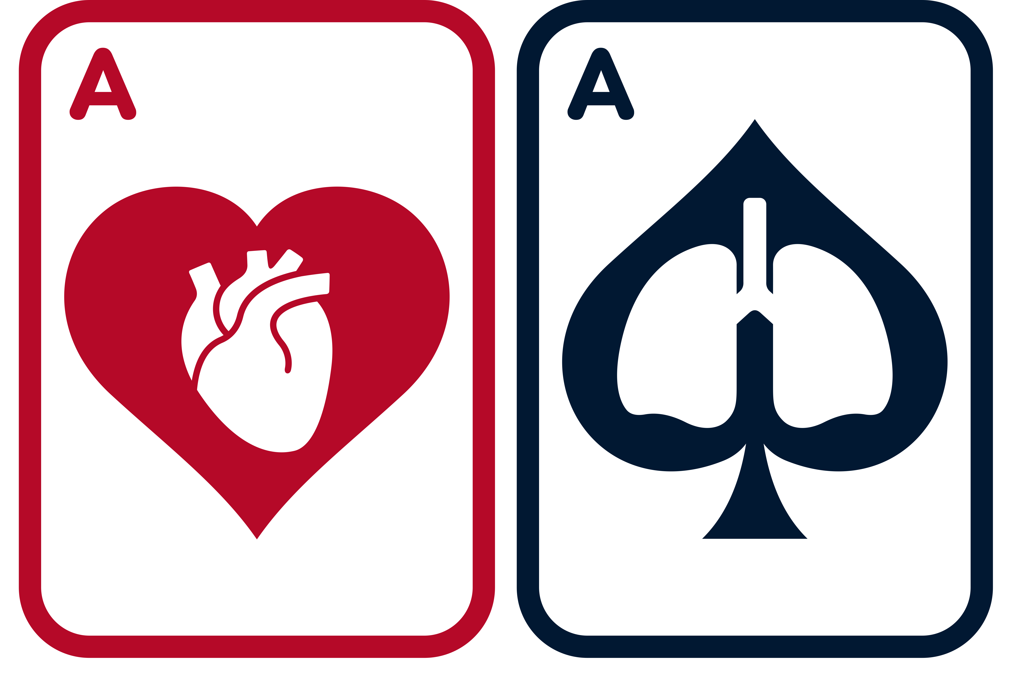

►Background | Aims | Methods | Results | Conclusions
Session Overview
Basic Concepts of Neural Networks (16:00 – 16:15)
Do it Yourself! (16:15 – 17:05)
  Step-by-step guide to training your own model
  Work in a team or individually
  Discussion: Does AI Have a Place in MCS? (17:05 – 17:45)
  Break into 6-8 teams and discuss
  If so, what would be most useful?
  Can you use the skills you’ve learned today to work towards this?
  Ideas shared with the class
  Interactive Notebook Available to Take Home
Prompt: create a dynamic visual of the waves crashing on the beach

Slide 3
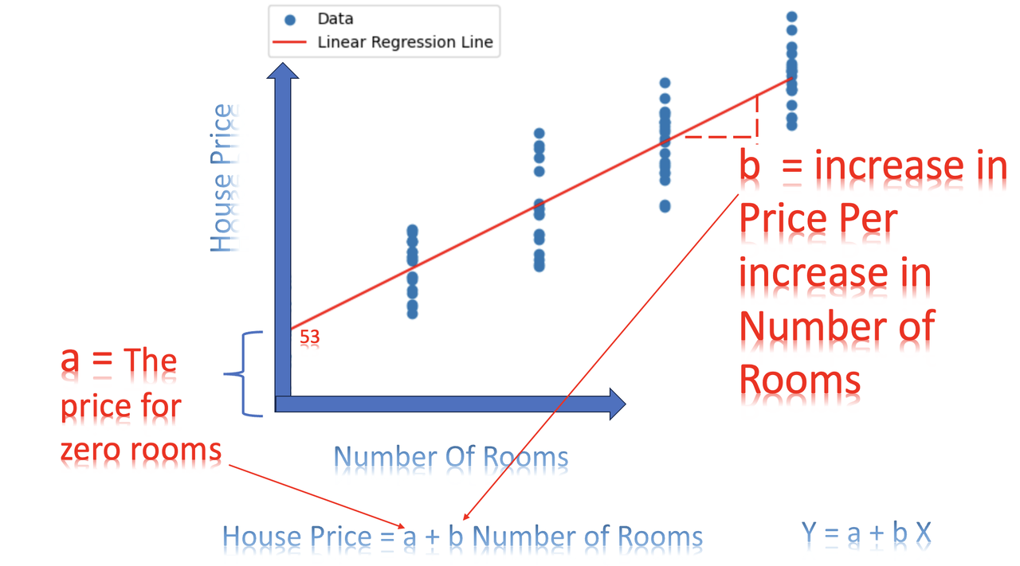
►Background | Aims | Methods | Results | Conclusions
What is a NN?
We will demystify some of the concepts involved in NN algorithms here
NN’s operate on a similar principle to brains – pattern recognition and reinforcement when it does a good job
NN’s are actually more similar to linear and logistic regression than you might think
NN’s can better model non-linear relationships

Slide 4
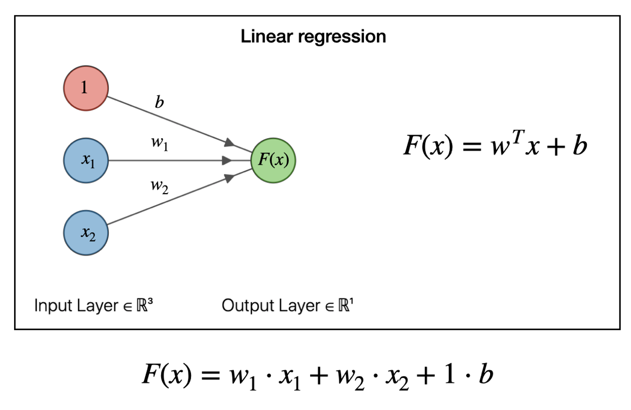
►Background | Aims | Methods | Results | Conclusions
Linear Regression
The linear regression consists of several inputs, each of which has a weight, and a single y-offset

Slide 5
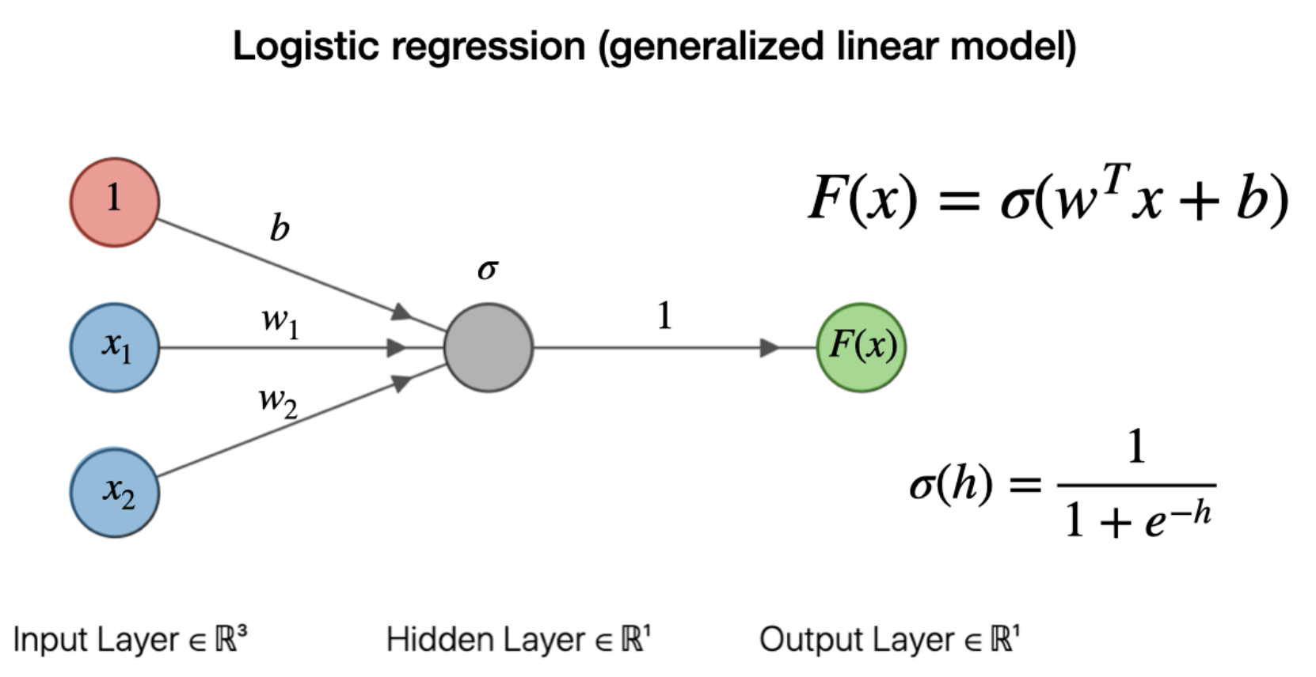
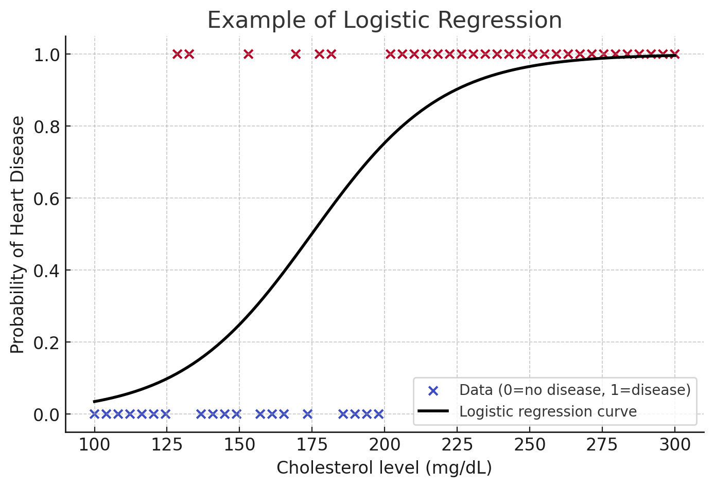

►Background | Aims | Methods | Results | Conclusions
Logistic Regression
This graph show how a single input variable of cholesterol is fitted to the sigmoid curve. More inputs can be added to create a surface
The logistic regression is used to map continuous data to an output prediction.
Logistic regression consists of sigmoid curve which is then scaled using weights and biases to give best fit

Slide 6
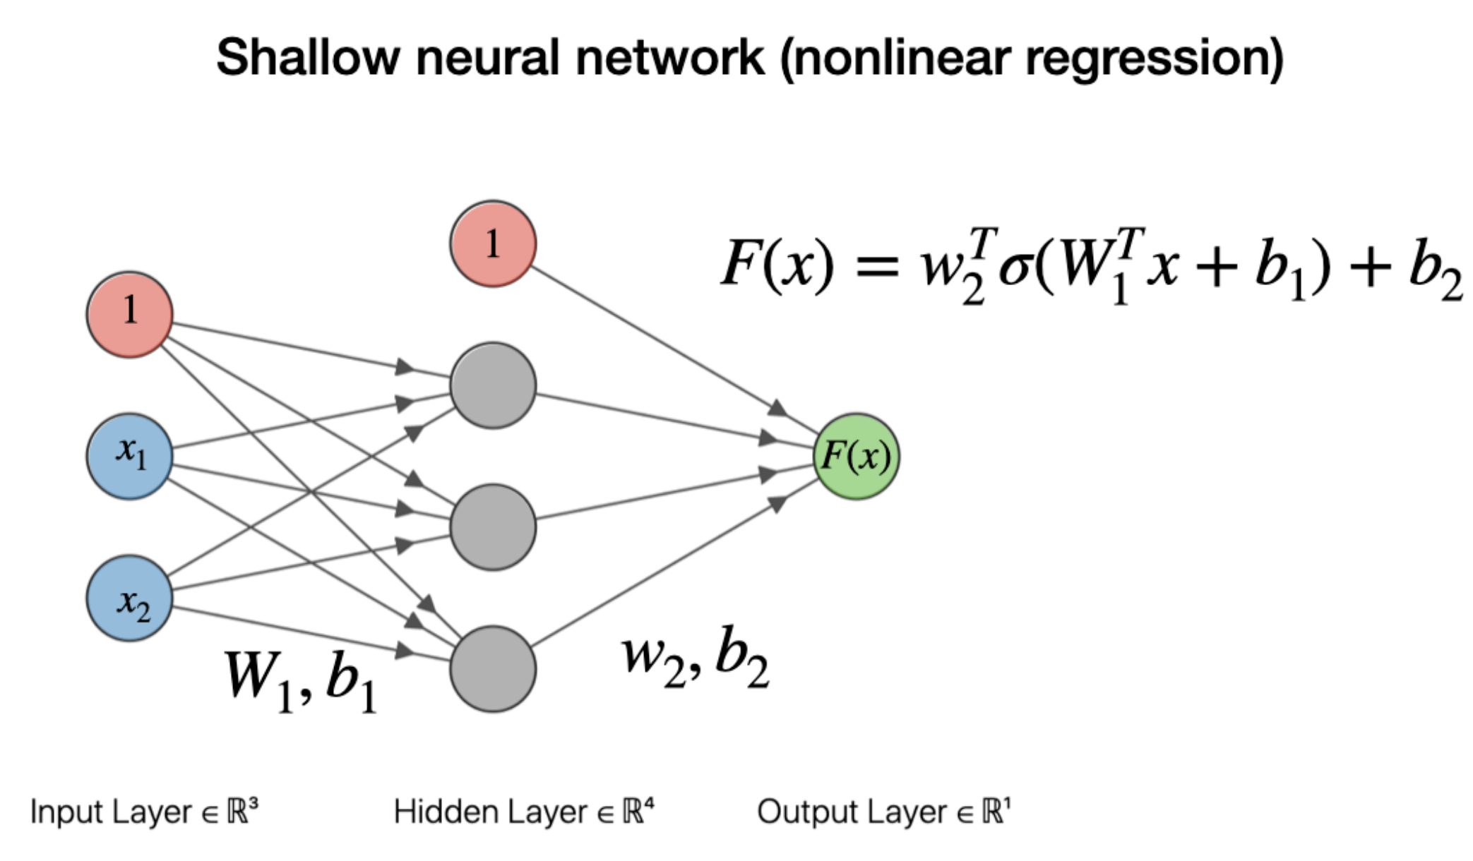
►Background | Aims | Methods | Results | Conclusions
Neural Network
This is the most complicated slide: stay with us!
Instead of the green dot’s inputs coming from the variables, the inputs come from neurons (grey dots).
In a neural network, the green dot at the end represents our sigmoid function which squishes our output to 1 or 0.
Each neuron applies a simple weight and bias to the data going into it and passes it to a non-linear activation function. The activation function then feeds the output layer

Slide 7
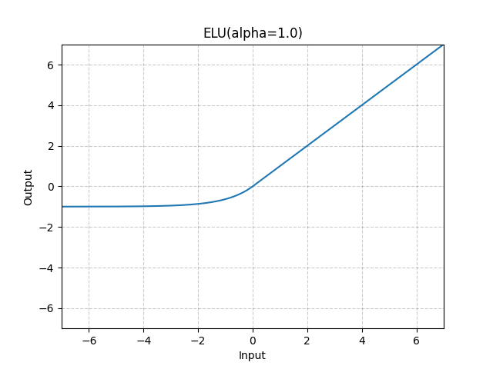
►Background | Aims | Methods | Results | Conclusions
Activation Function
Each neuron passes their outputs to an activation layer
Activation layers act as a gate, controlling how much of each signal gets through. This makes the function non-linear.
Most activation layers pass through stronger signals, while removing weaker ones
Activation layers come in many different functions, the most common is ELU
ELU only passes through strong positive signals. This is equivalent to passing a recognised pattern forward, while turning off the neuron if no pattern is recognised (reducing noise)

Slide 8
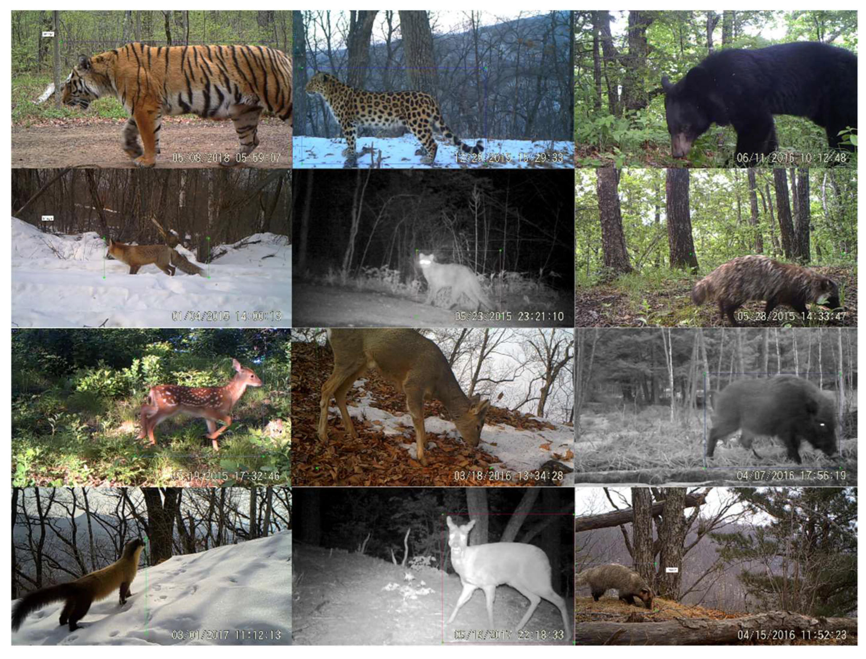
►Background | Aims | Methods | Results | Conclusions
The combination of neuron and activation layer means each neuron learns different features of the data.
Each neuron gains focused expertise. By combining their expertise, we can gather enough information to make a decision
The reason each neuron learns differently is because they start at different locations

Slide 9
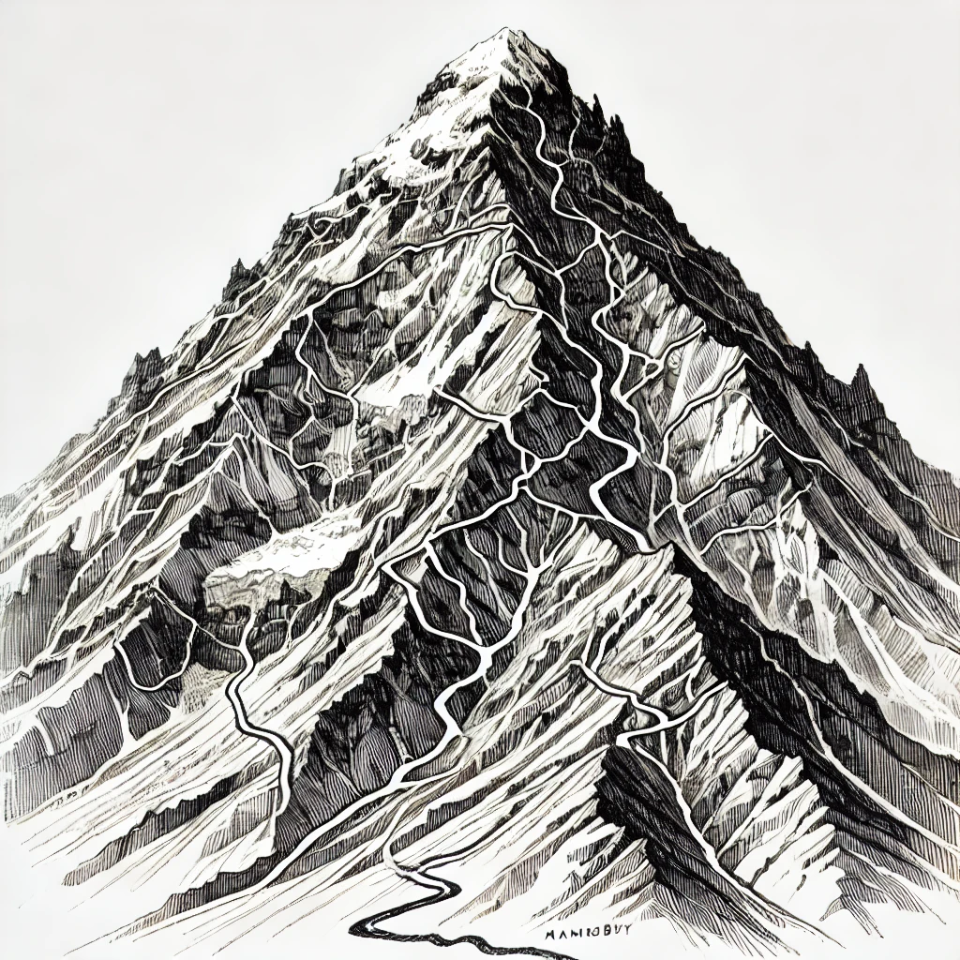
►Background | Aims | Methods | Results | Conclusions
Neural Network
Imagine we drop several people off at random locations on a mountain
Each person is tasked to find their way down the mountain (minimising the gradient)
As they descend, each person faces different terrain, and learns how to navigate that specific terrain efficiently (ravines, sheer faces, scree)
When they reconvene at the bottom of the mountain, they can combine their specific knowledge to solve the general problem of quickly descending the mountain.
This is a good analogy for Neural Networks!

Slide 10
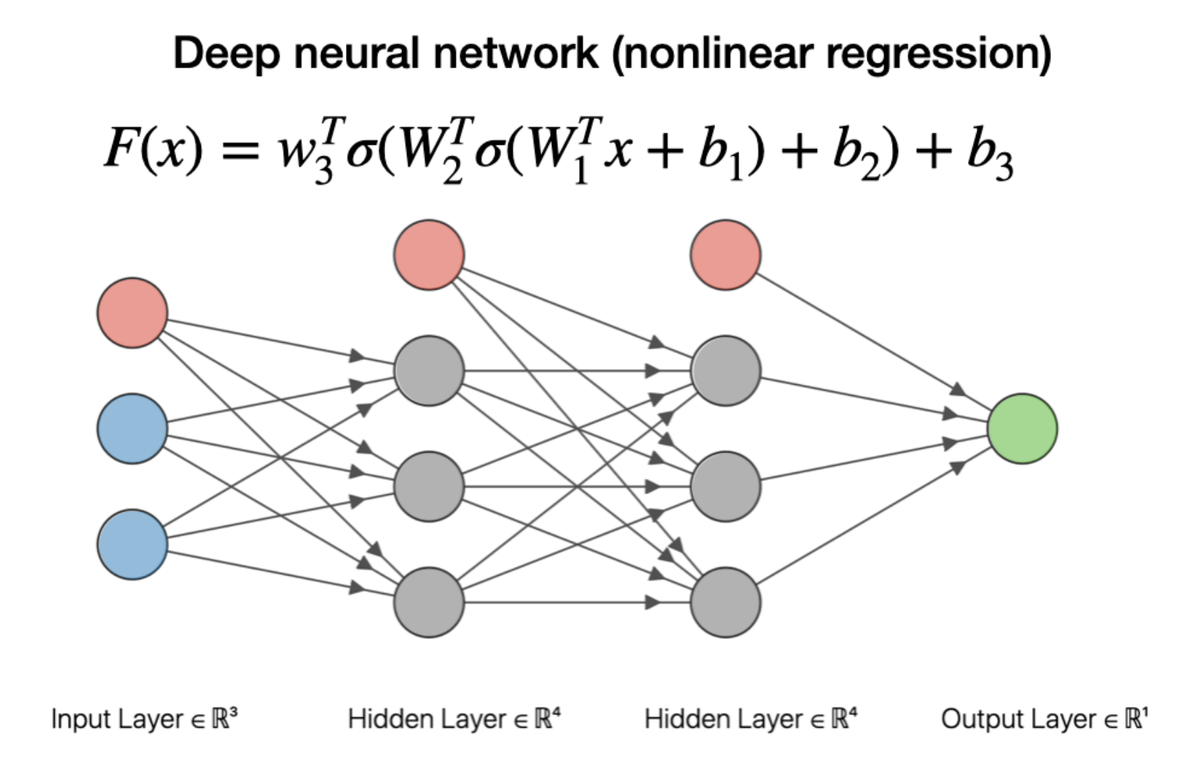
►Background | Aims | Methods | Results | Conclusions
Deep Neural Networks
As we add more hidden layers, the NN can further abstract relationships. Focusing not only on features, but also on increasingly complex interactions with each other

Slide 11
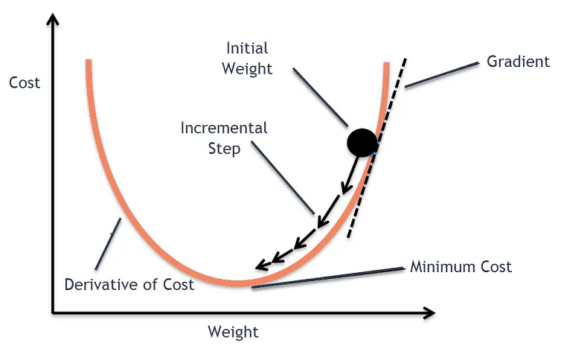
►Background | Aims | Methods | Results | Conclusions
Model Training Steps
Just like minimising the error when fitting our sigmoid in LR
Model training consists of:
  Make a random prediction
  Compare it to the true answer
  Use back propagation to see how each neuron affected the prediction
  Adjust the weights to attempt to reduce that error (gradient descent, optimizers)
  Rinse and repeat several thousand times
Gradient descent is a simple way to adjust the weights to find the best fit. As each neuron’s error gets smaller, the step size decreases.

Slide 12
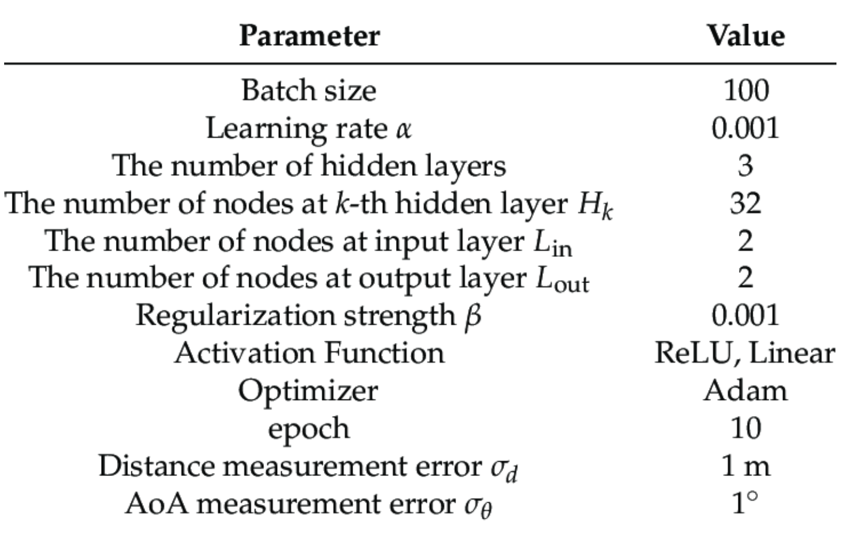
►Background | Aims | Methods | Results | Conclusions
Hyperparameters
Hyperparameters are used to adjust the way the model trains, to force it to learn in different ways.

Slide 13





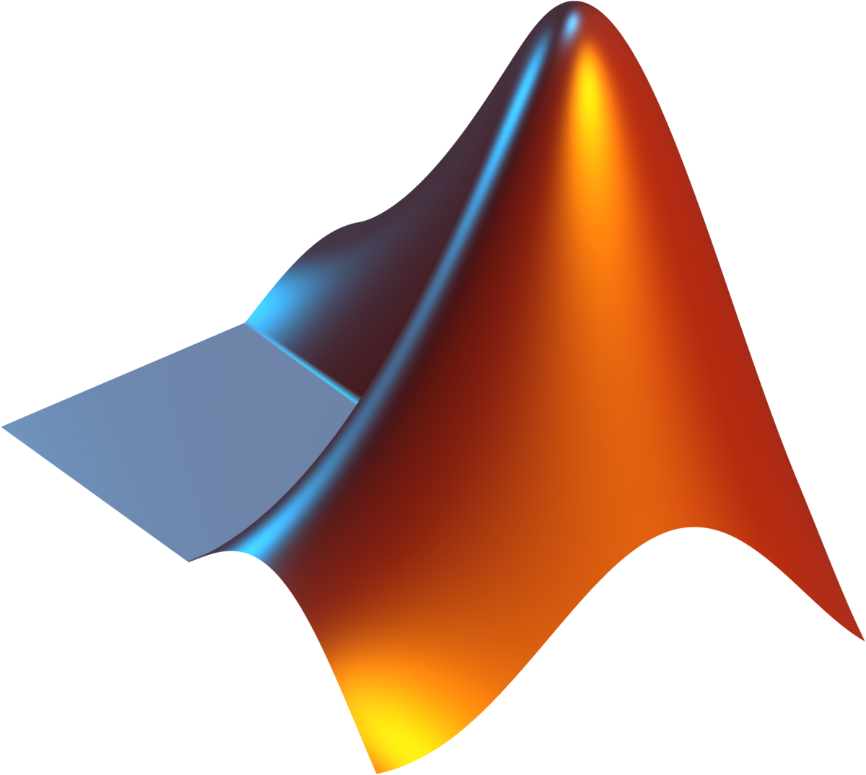

►Background | Aims | Methods | Results | Conclusions
AI Made Accessible!
Toolbox and packages available
Gold standard

Slide 14
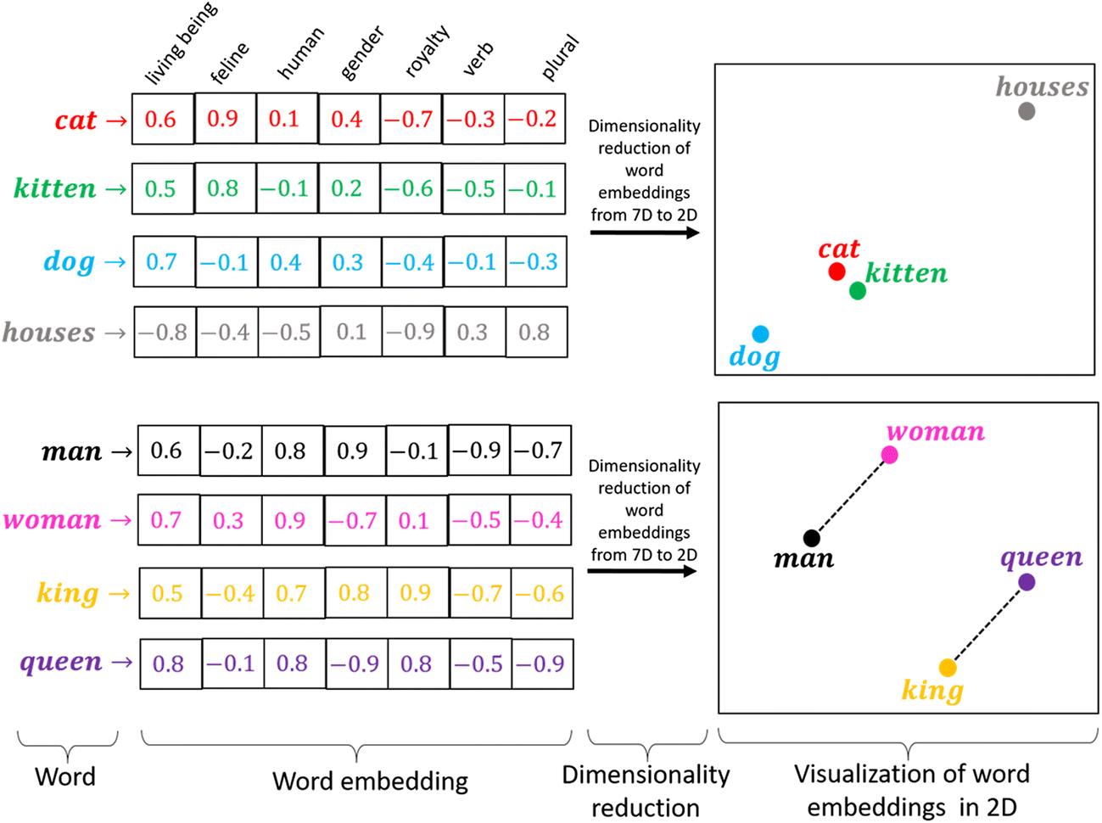
►Background | Aims | Methods | Results | Conclusions
Primer on Data Prep
NN’s can only work with numbers
  Categoricals encoded binary/ordinal
  Multi-dimensional ideas can be reduced
  Data should be normalised
  Outliers can significantly bias training and normalization
  Outcomes should be reasonably balanced
Notes:
The heart contains multiple chambers separated by valves that ensure forward flow…

Slide 15
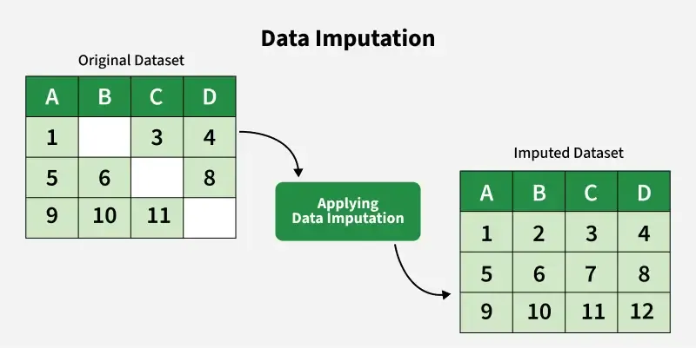
►Background | Aims | Methods | Results | Conclusions
Primer on Data Prep
NN’s won’t accept missing data
Popular imputation methods include
  MICE
  Mean/Median
  KNN
  Random Forrest
Notes:
The heart contains multiple chambers separated by valves that ensure forward flow…

Slide 16
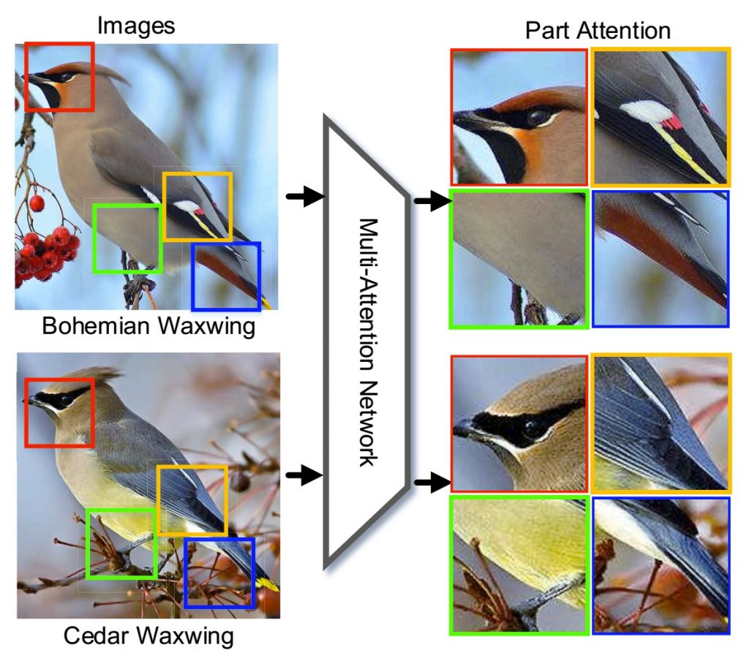
►Background | Aims | Methods | Results | Conclusions
Summary
NN’s are not too different from logistic regression, they are just more non-linear
They consist of inputs, hidden layers, and an output function
  Hidden layers consist of a neuron and an activation function which can learn different features
  By combining specific neuron expertise, we can solve generalised problems
Notes:
The heart contains multiple chambers separated by valves that ensure forward flow…

Slide 17

►Background | Aims | Methods | Results | Conclusions
Let’s Go!
Follow the work sheet
40 mins working time
Work individually or in groups
We will come around and help you
Download the workshop notebook from ausmcs.org/
colab.google/
Open the workshop notebook File → Open Notebook
Notes:
The heart contains multiple chambers separated by valves that ensure forward flow…

Slide 18

►Background | Aims | Methods | Results | Conclusions
Discussion
Does AI have a place in MCS? (40 mins)
  Break into 6-8 teams and discuss
  If so, what would be most useful?
  Can you use the skills you’ve learned today to work towards this? (20 mins)
  Ideas shared with the class (20 mins)
Prompt: Conference colleagues in small groups discussing important topics in a flat floor workshop. View from the front of the room, where the lecturer would be standing
Notes:
The heart contains multiple chambers separated by valves that ensure forward flow…

Slide 19

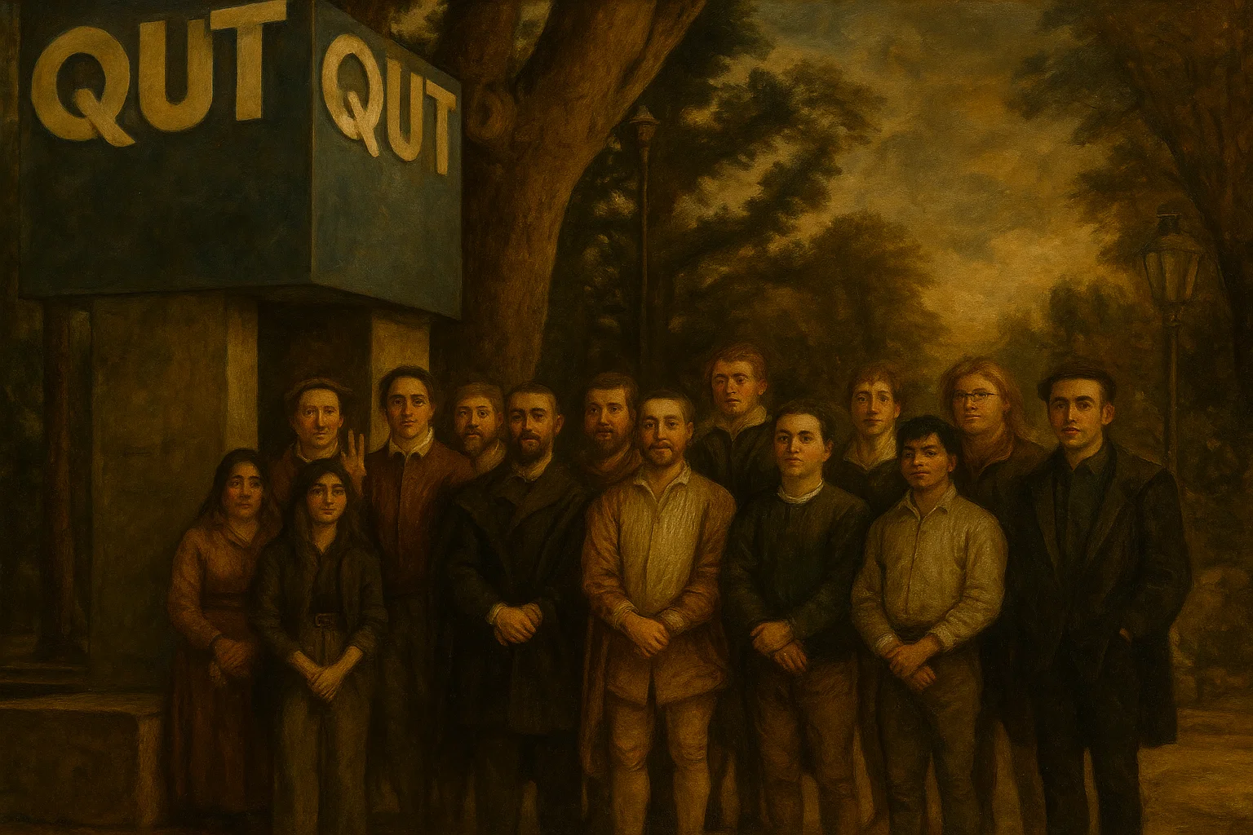
THANKS!
Andrew.F.Stephens@qut.edu.au
emmanelly.vandewouwer@hdr.qut.edu.au

